Slide 1


Consumer goods ad-hoc insights
LinkedIn
GitHub
AtliQ Hardwares
Presenter : Manoj SONAWANE

Slide 2

AGENDA
Background
Understanding AtliQs Business Operations
Familiarizing With Input Data
Addressing Ad-hoc Requests Through Query Results, Visualization, And Insights

Slide 3
BACKGROUND
INTRODUCTION
Atliq Hardwares: Leading computer hardware producer in India
Global Presence: Expanded operations to other countries
Lack of Insights: Management struggles to make quick and informed decisions
Need for Expansion: Recognized the necessity to strengthen data analytics capabilities
Recognizing the pivotal role of data analytics in driving competitive advantage, Atliq Hardwares is committed to bolstering its analytical capabilities to enable proactive decision-making and strategic foresight.
1
AtliQ Hardwares

Slide 4
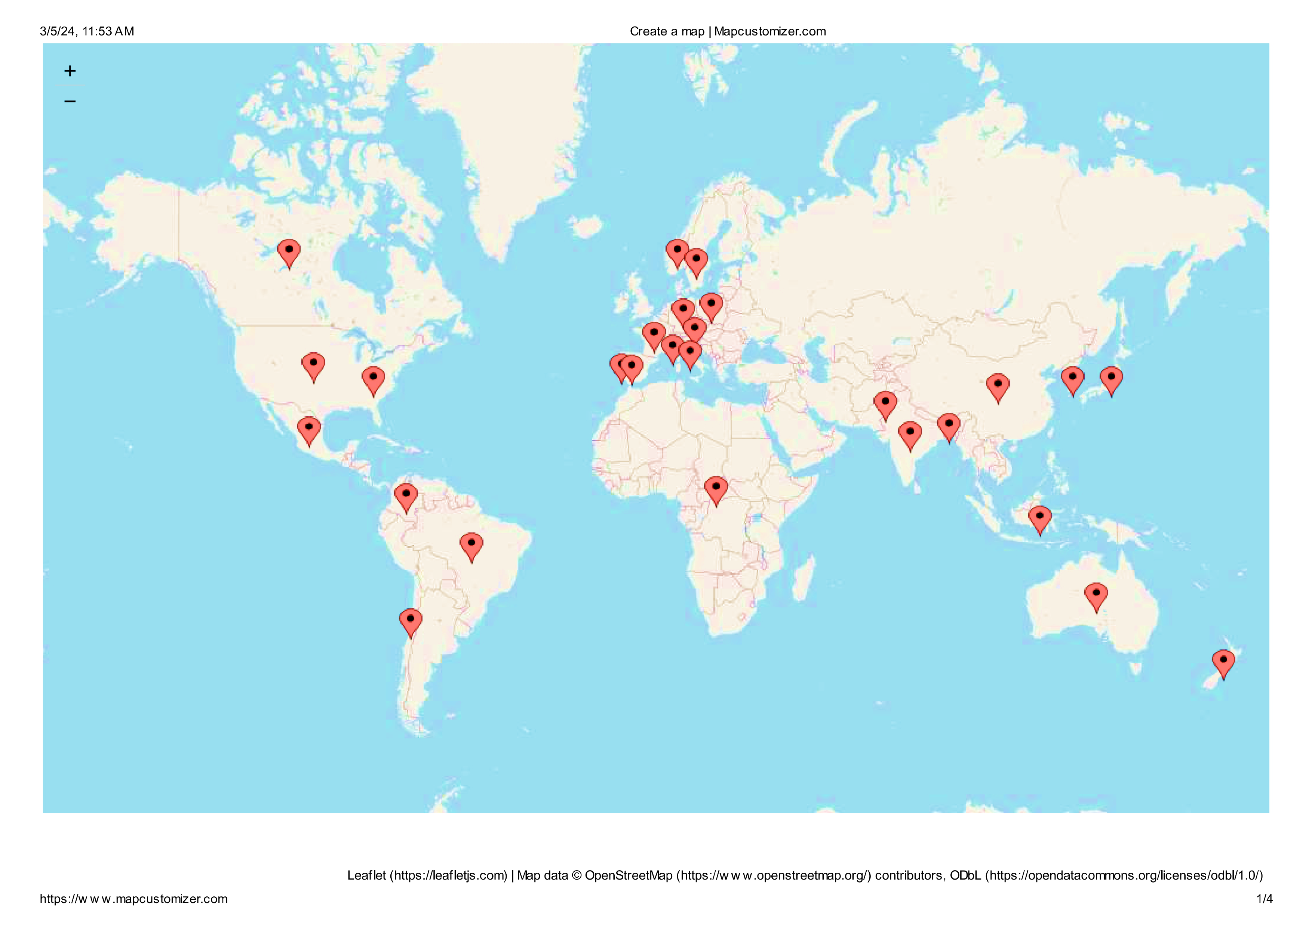
2
MARKET
CONSUMER GOODS AD-HOC INSIGHTS

Slide 5
2
PRODUCT LINE
PC
P & A
N & S
DESKTOP
Business Laptop
Personal Laptop
NOTEBOOK
Gaming Laptop
Business Laptop
Personal Laptop
PERIPHERALS
Graphic Card
ACCESSORIES
Batteries
Internal Hdd
Motherboard
Processors
Keyboard
Mouse
NETWORKING
Wifi Extender
STORAGE
External Ssd
Usb Flash Drives

Slide 6
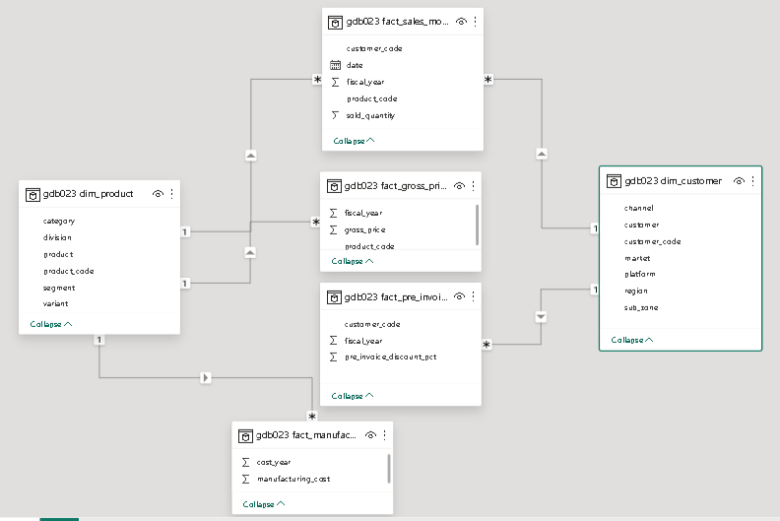
Familiarizing with input data
3
Consist of sales data for FY 2020 & FY 2021

Slide 7
Addressing Ad-hoc Requests
4

Slide 8
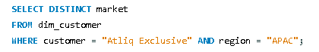
Query
1
Result
market
India
Indonesia
Japan
Philiphines
South Korea
Australia
New Zealand
Bangladesh
Provide the list of markets in which customer "Atliq Exclusive" operates its business in the APAC regions

Slide 9
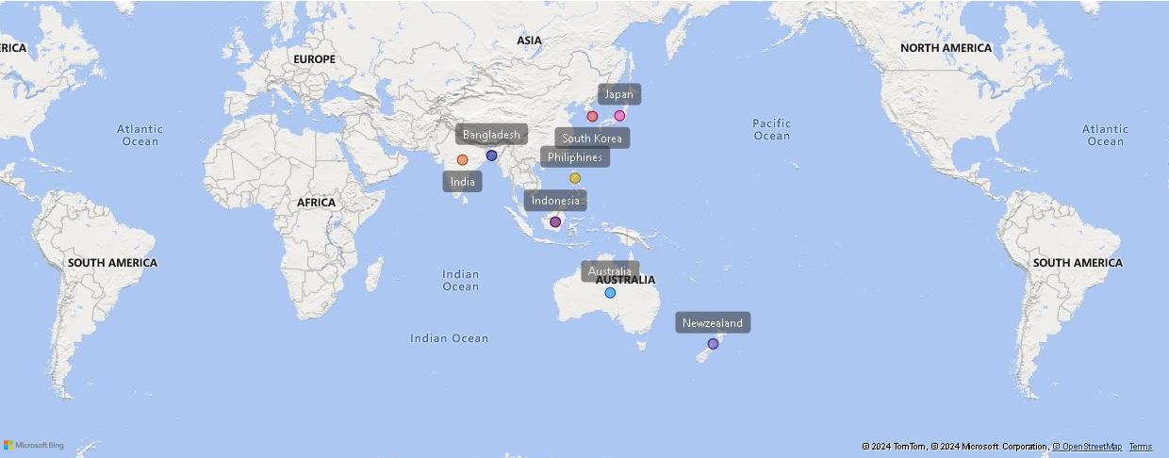
"Atliq Exclusive" conducts its operations across the APAC region, spanning eight countries.

Slide 10
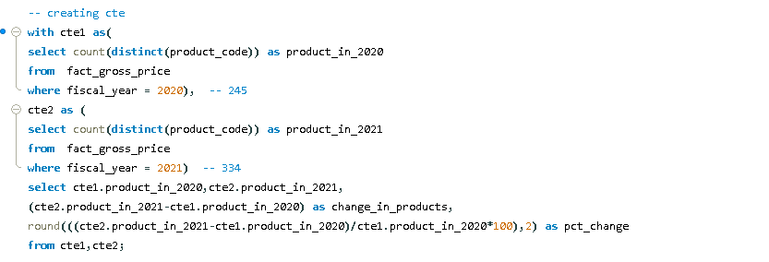
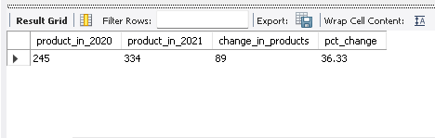
2
What is the percentage of Unique product increase in 2021 vs 2020 ?
Query
Result

Slide 11
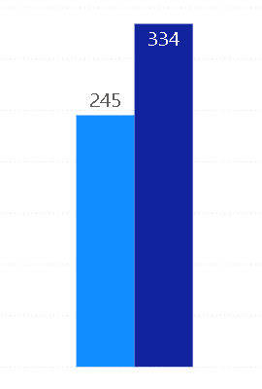
Unique product increase in 2021 vs 2020
89
Quantity Change
% Change
89
36.33 %
2020
2021

Slide 12
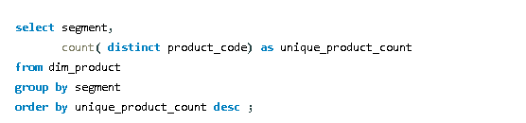
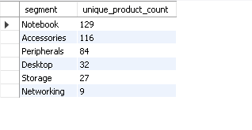
3
Provide a report with all unique product counts for each segment and sort them in descending order of product counts?
Query
Result

Slide 13
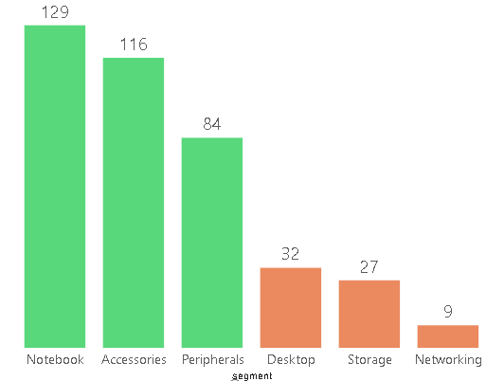
Unique product count for each segment
Avg
109
Avg
22
The segments of notebooks, accessories, and peripherals show a higher diversity of unique products compared to desktops, storage, and networking, suggesting potential market focus and opportunities for growth
2020
2021

Slide 14
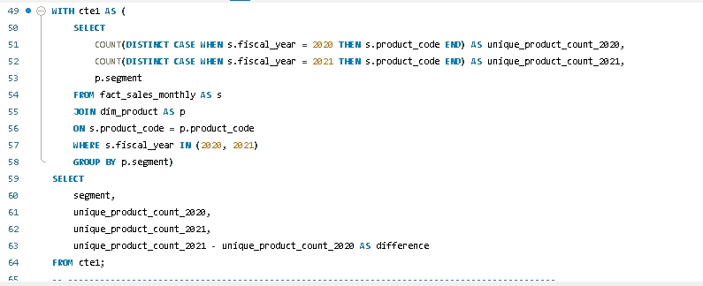
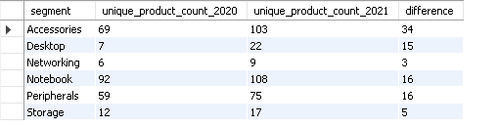
4
which segment had the most increase in unique products in 2021 vs 2020 ?
Query
Result

Slide 15
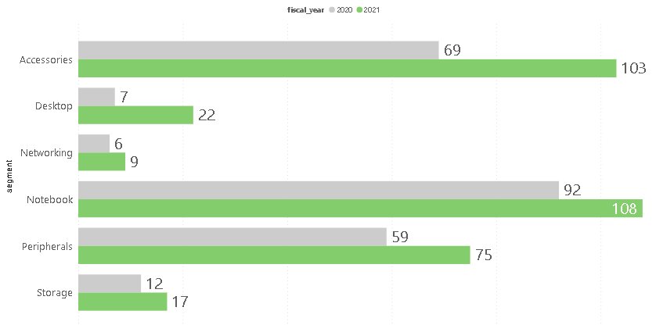
34
15
3
16
16
5
2020
2021

Slide 16
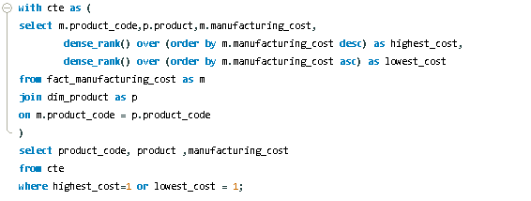
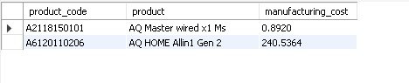
5
Get the products that have highest and lowest manufacturing costs.
Query
Result

Slide 17


Which of our product has highest manufacturing cost ?
Which of our product has lowest manufacturing cost ?
$ 240.53
$ 240.53
$ 0.89
AQ Home Allin 1 Gen 2
AQ master wired x 1 ms

Slide 18
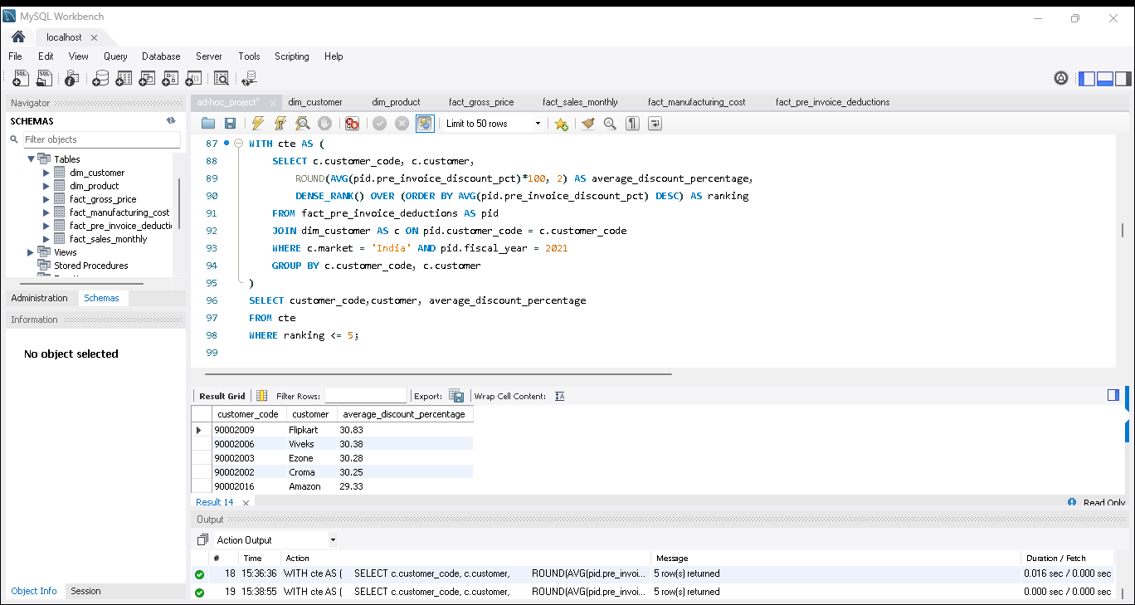
6
Generate a report which contains the top 5 customer who received an average high pre invoice discount percentage
- for the fiscal year 2021 and in the Indian market
Query
Result

Slide 19
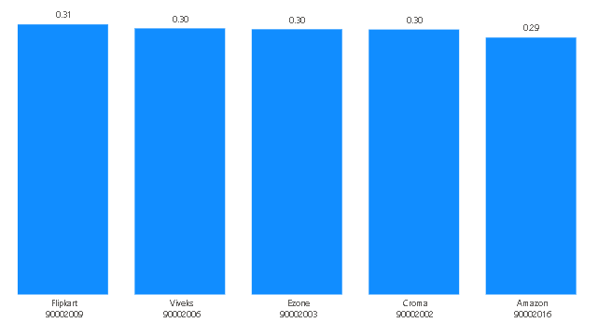
In 2021, we provided nearly identical pre-invoice discounts to our top 5 customers.
30.83 %
30.38 %
30.28 %
30.25 %
29.33 %

Slide 20
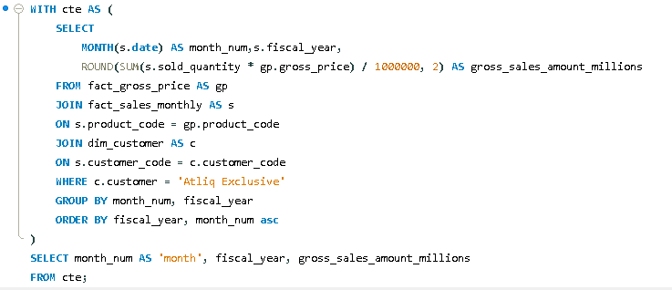
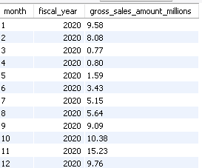
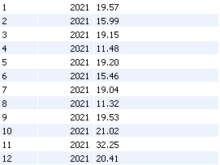
7
Get the complete report for the gross sales amount for the customer 'AtliQ Exclusive' for each month.
This analysis helps to get an idea of low and high-performing months and take strategic decisions
Query
Result
High Performing Months
High Performing Months

Slide 21
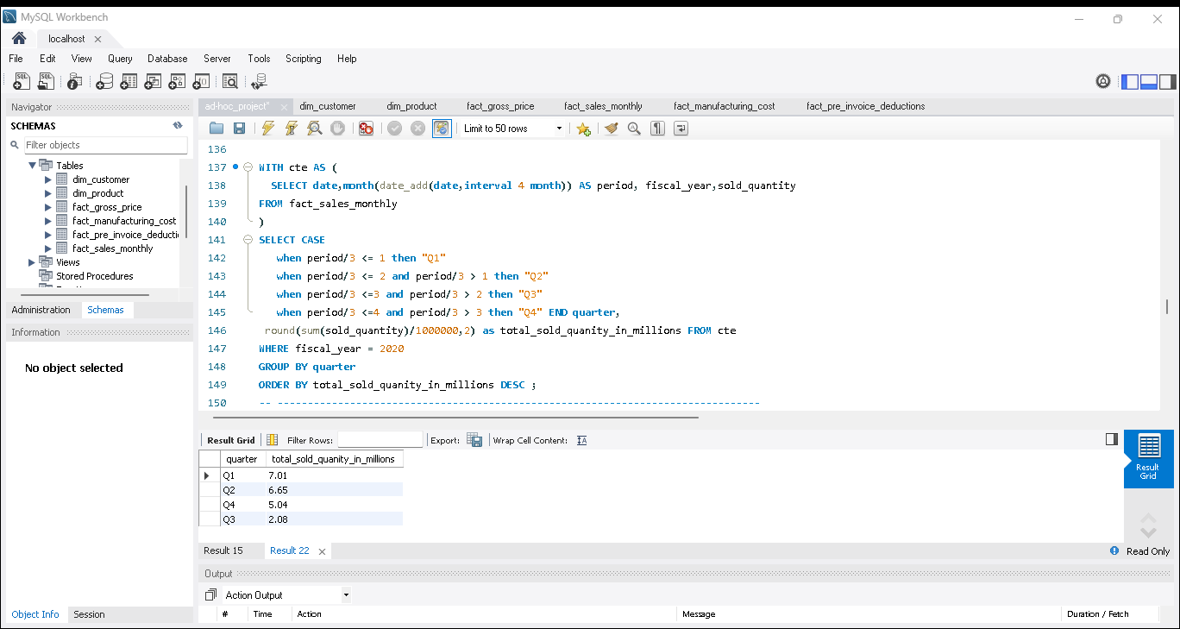
8
In which quarter of 2020, got the maximum total sold quantity?
Query
Result
Max qty sold in Q1

Slide 22
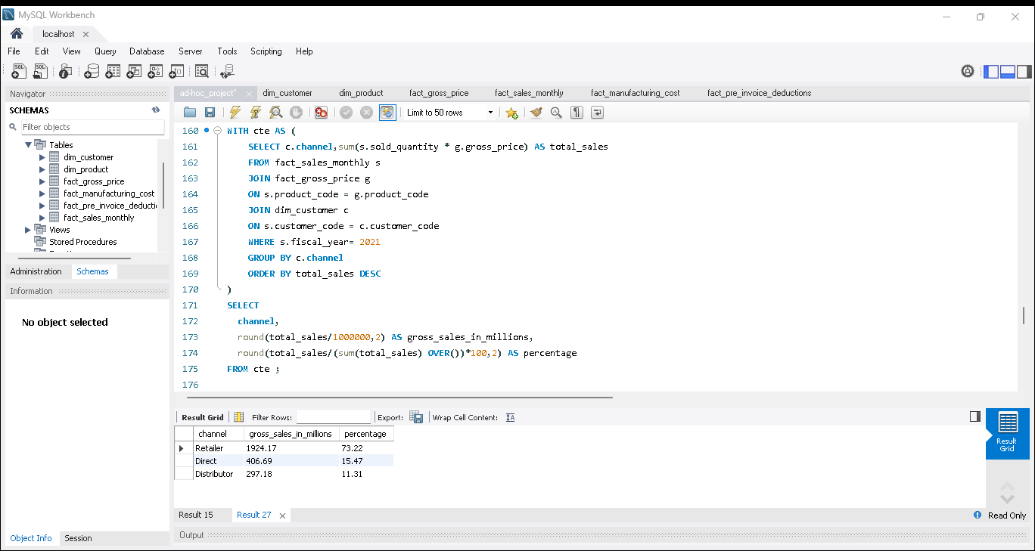
9
Which channel helped to bring more gross sales in the fiscal year 2021 and the percentage of contribution?
Query
Result

Slide 23
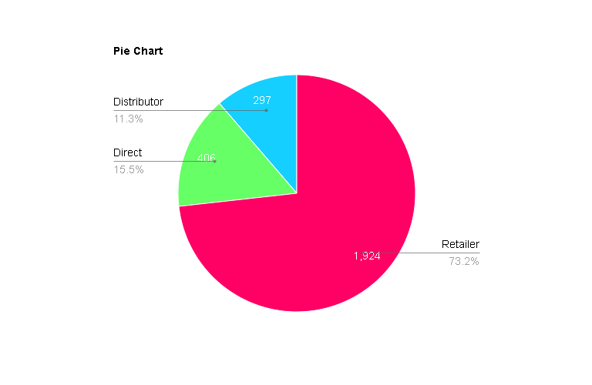
Retailor sales dominate with 73.2% of total sales, indicating their pivotal role.
Direct sales contribute significantly at 16.5 %, while Distributor sales, though lower at 11.3 %, still represent a notable share.
All the values are in millions

Slide 24
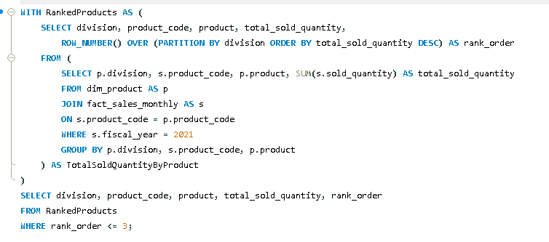
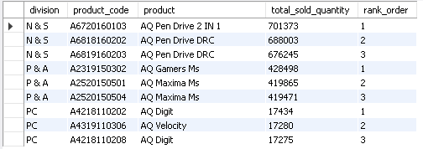
10
Get the Top 3 products in each division that have a high total sold quantity in the fiscal_year 2021
Query
Result

Slide 25
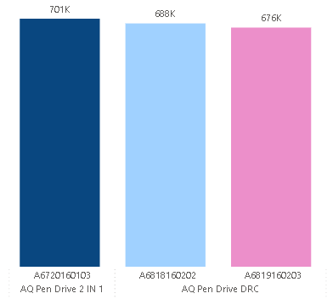
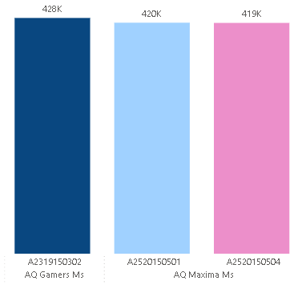
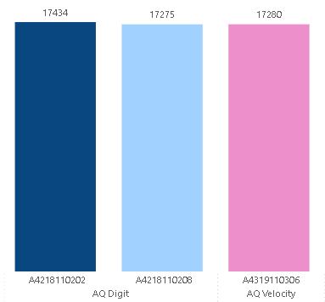
The top 3 selling products in the N & S divisions are Pen drives, collectively contributing 20 lakhs in sold quantity.
The top 3 selling products in the P & A divisions mouse, collectively contributing 12 lakhs in sold quantity.
The top 3 selling products in the PC divisions are Personal Computers, collectively contributing 51 Thousands in sold quantity.
1
2
3
1
2
3
1
2
3
N & S
P & A
PC

Slide 26


Thank you
Dhaval
Patel
Hemanand
Vadivel
Founder - Codebasics
Co-Founder - Codebasics

Slide 27
THANK YOU
Manoj Sonawane
manojsonawane133@gmail.com
LinkedIn
GitHub

